Slide 1

Welcome

Slide 2
STEP NATIONAL EDUCATION CONFERENCE 2018 Positive engagement with and for the families of children and young people with learning difficulties Nell Page and Dinah Aitken
Notes:
DINAH – Good morning. Thank you for coming to the workshop this morning. My name is Dinah Aitken and I’m here today with my colleague, Nell Page, to introduce you to The Salvesen Mindroom Centre and explain the services we provide in the hope that we may be able to support you to work with families that have a child or young person affected by a learning difficulty.
In this session, we will talk about the service, and demonstrate both our method of working and also give examples of some of the practical resources we provide. We hope to pause the talk at one or two points to offer you a chance to ask questions, and give your view of the challenges that occur in the sorts of situation we will be describing.

Slide 3
The Salvesen Mindroom Centre’s vision
A world where no mind is left behind and every person with learning difficulties receives the recognition and support they need to achieve their potential.
Access better support
Empowerment
Effective engagement
What’s different about The Salvesen Mindroom Centre?
Diagnosis unnecessary
Collaborative working
Child and young person always at the centre
Notes:
The organisation was set up by a parent in 2000, and has grown from ‘kitchen table’ to the current 10 staff, soon to be 12. We cover the whole of Scotland, and this is our vision.
We occupy a niche in the voluntary sector as we don’t demand a diagnosis before families can seek our help, we promote collaborative working wherever we can, and we always keep the child at the centre.

Slide 4
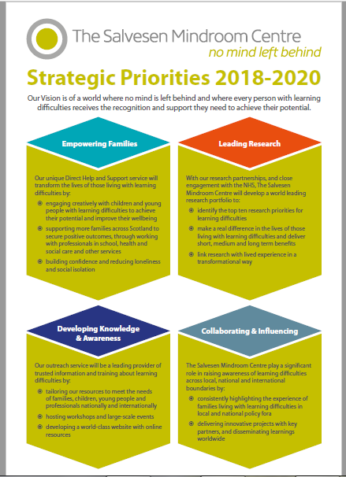
Notes:
This is our strategic vision for 2018 – 2020, built around the 4 aims of:
Empowering families
Leading Research
Developing Knowledge and Awareness, and
Collaborating & Influencing
Our vision of how we will build up The Salvesen Mindroom Centre is focussed on all 4 areas. We are very active in all 4, but today we’ll focus on the first of our four aims – Empowering families, and how we do this through providing a service we call Direct Help and Support.

Slide 5
Notes:
Before we embark on that story, we wanted to show you this slide. Our founder, Sophie Dow, was adamant that hope should be present in all the work we do. And we believe that hope and optimism should be core within the lives of all young people and the words on this slide were gathered in our office to represent how we work to try to make this aspiration a reality.

Slide 6
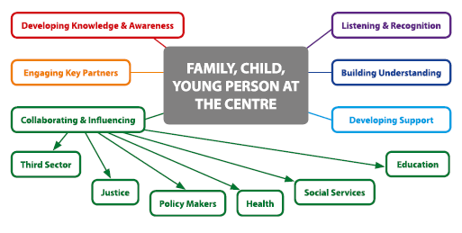
Our Outreach Model
Notes:
We have visualized all the work we do as an outreach model – the main element of this is that we keep the child and young person, with their family, at the centre. Our current structure and the skillset of the team means that we work with parents and carers – they are what you might call ‘the client’, but the focus stays on the child or young person’s needs. (We are recruiting a young person’s worker, so we should be able to begin working more directly with CYP in the near future).
I’ll hand over to Nell now to explore in more detail our engagement with and support to parents.

Slide 7
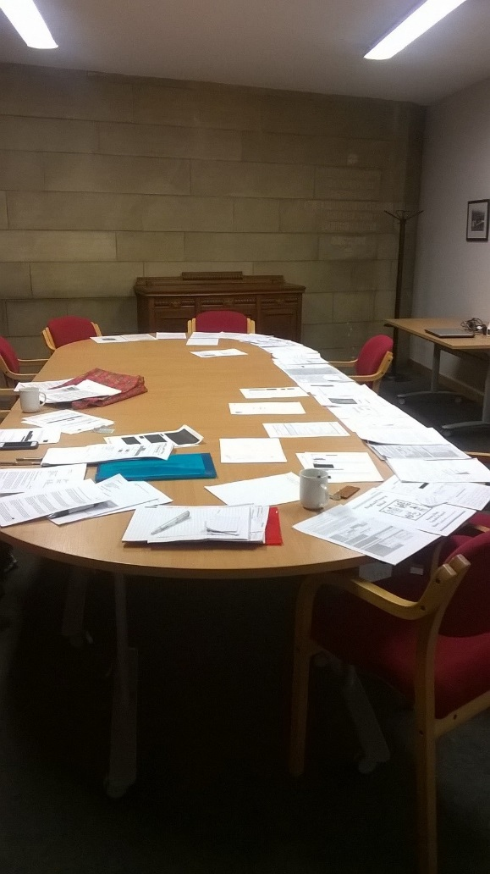
The Salvesen Mindroom Centre’s 1:1 support (1)
Reduce immediate stresses
Inform and empower parents and carers
Raise awareness of rights and responsibilities
Increase the knowledge and awareness of professionals
Meet an identified gap in services to families
Notes:
NELL
Our key service is the 1:1 support we offer to families. We call this our Direct Help and Support service, which we often shorten to DHS, so when you hear us say DHS, this is what we mean. The individual nature of the support is immensely important because families often find the situation they are in to be extremely stressful, for all sorts of reasons. This picture ( the stuff on the table! ) shows a case in progress and give some idea of the volume of paperwork that can group around a single child or young person. That is a highly stressful situation to have to cope with, and it can seem overwhelming.
CLICK FOR BULLET POINT ONE
Having support from The Salvesen Mindroom Centre can help to reduce the stress for everyone in the family.
CLICK FOR BULLET POINT TWO
Our first step is to inform and empower parents. It is so important to have the correct information and to know about the rights and entitlements each child and family has. With this type of knowledge, it is far, far easier for parents and carers to ask for services from schools, health professionals and social service providers. Sometimes you have to stand your ground and insist that something is done, and having the right amount of knowledge is vital to enable you to do this. This is empowering.
CLICK FOR BULLET POINT THREE
Children and young people have a wide range of rights – the right to an education, the right to be educated so that they can achieve their full potential, the right not to be discriminated against and so on. We try to make sure everyone understands that these are rights, so that everyone is clear the rights must be upheld. That includes professionals.
CLICK FOR BULLET POINT FOUR
We assume that professionals are experts, but sometimes they are lost as to what they could and should be doing, and we work in a way that ensures that professionals become more aware of the needs of children and young people, who has the duty to meet those needs and how best they can be met. We do not approach professionals in a confrontational way, and we encourage families to find a way forward that is non-confrontational, too.
CLICK FOR BULLET POINT FIVE
We know our service is needed because we are always busy. As far as we can, we try to step into the gap and help families to feel supported and more confident about securing appropriate help now and in the future.

Slide 8
Key statistics
26.6%
Of pupils have ASN
Children who are bullied are 4x more likely to have poor mental health
Pupils with ASN 5x more likely to be excluded
5 children in every classroom have a learning difficulty
2/3 of pupils with learning disabilities/autism have been bullied
Notes:
Why do the parent’s who contact us need support? I’m going to start with some stats!
In 2017 more than ¼ of pupils in Scottish schools were recorded as having additional support needs. ( ASN )
It is estimated that 5 children in every classroom has a learning difficulty. In a recent report 2 out of 3 pupils with a learning disability or autism said they had been bullied. This has clear consequences for their mental health.
Children with an Additional Support Need are 4.9 (effectively, 5) times more likely to be excluded from school .

Slide 9
Scottish education - some numbers (1)
The number of teachers with Additional Support for Learning as their main subject has fallen by 15% from 3,402 in 2009 to 2,896 in 2016.
Notes:
This is the extent of the drop in ASL specialist teachers, which sits in contrast to the growing numbers of pupils recorded as having Additional Support Needs.
Answer by John Swinney on 30.12.16 to PQ:S5W-05579

Slide 10
Scottish education - some numbers (2)
Children often feel they are being ‘punished’ because of their additional support needs
The number of pupils with ASN related to mental health problems more than doubled between 2011 and 2015
The waiting time target to access Child and Adolescent Mental Health Services is 18 weeks
Half of children and young people start their treatment within 12 weeks. Approximately three quarters of children and young people (73.3%) were seen within 18 weeks.
Notes:
Children and young people often feel they are being punished for their additional support needs and many experience bullying
There is an alarming rise in the number of pupils experiencing mental health issues and a concerning failure of the Child and Adolescent Mental Health Service to provide the much needed support in a timely manner.
Source:
Included in the Main?! (Enable Scotland, 2016).
State of Children’s Rights in Scotland (Together, 2016)
SPICe Briefing16/76 (2016): Child and Adolescent Mental Health –Trends and Key Issues (Scottish Parliament, 2016)
ISD CAMHS in Scotland: Waiting Times, Service Demand, and Workforce. Quarter ending 30 September 2017. Publication date – 5 December 2017

Slide 11
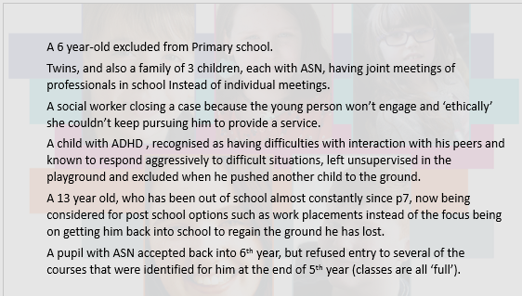
What do the stats really represent? DHS examples:
Notes:
This slide shows how the statistics we have talked about translate into the cases we deal with on a daily basis in Direct Help and Support. In the slides to follow, we will try to put even more context around the reality of daily life for the families we support.
Many of the parents who contact us tell us that their child has been excluded and it is not uncommon to hear that this is happening to very young children in primary school.
We often hear from parents that because a young person can’t or won’t engage services are withdrawn.
Sometimes the plans put in place for children and young people do not seem to reflect the small steps which are necessary to facilitate effective outcomes for them – for example focusing on work placements for a young person who has been out of school for lengthy periods, rather than focusing on supporting them to return to school in the first instance.

Slide 12
Demand – Direct Help and Support (DHS)
Average 26 initial enquiries each month
Active caseload varied between 204 and 259 per month in 2017
Average 15 family focussed meetings each month with key collaborators
Engaged in 25 of 32 local authorities in 2017
Distributed 85,000 paper copies of It Takes all Kinds of Minds (2017)
30,000 visits to our website in 2017
Social media - growing reach
Notes:
Last year we responded to an average of 26 initial enquiries each month and had between 204 and 259 cases which were active during that year
We were engaged in 25 out of 32 local authorities last year
We distributed 85,000 copies of our publication ‘It takes all kinds of minds’
So we have been busy! And there is continuing demand for our services

Slide 13
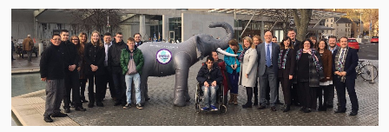
Presumption of mainstream
National policy
What happens when it goes wrong?
What are the alternatives?
Notes:
As you are aware it is national policy that every child should be educated in a mainstream setting – and that is a parental choice that many families make.
But, as Enable (pictured) showed with their well-researched document, and campaign, ‘Included in the main?!’ mainstream education often leaves children lonely, subject to bullying, and not near to achieving their full potential.
We have supported many parents to seek alternatives to mainstream in the best interests of the child or young person in their family. This often involves a contested process using the placing request procedures available in each local authority.

Slide 14
Over–lapping or Coexisting Conditions
ADHD
ASD
Bipolar
Disorder
ODD
Depression
Dyslexia
Sleep Disorder
TS
Substance Abuse
DCD
Notes:
As a result of the mainstreaming policy, teachers could be supporting children with any combination from the range of conditions that give rise to learning difficulties. In our experience, it is extremely common to see co-existing conditions.
This means that the issues faced by these children and young people are complex and the solutions to support them should be tailored to the individual.

Slide 15




Notes:
What might be going on for the children in your classroom? Does anyone have any ideas what these pictures represent?
These images represent the impact that everyday struggles may have on children with additional support needs.
We often use ‘the coke bottle effect’ to demonstrate that every time a child or young person encounters something during their day which they find difficult, the bottle is shaken a little more – it could be the room is too noisy or the lights are too bright: they didn’t understand an instruction; their clothes are itchy and uncomfortable, and so on. However, you can’t see that this is happening and it is not until you take the cap off (most often when the child is at home) that there is an explosion.
The iceberg is a simple one, showing that we may only be aware of a small amount of what is happening for a child or young person. They may be struggling with a great deal under the surface which remains hidden.
The tower of bricks demonstrates the increasing load a child or young person has to carry throughout the day. A young person described to us the feeling of having more and more bricks added until he was weighed down.

Slide 16
Children out of school, out of learning
Reasons:
Bullying
Inadequate classroom support
Anxiety, mental health issues
School refusal/phobia
Numbers: no good national data
Frequency: anecdotally, we know this is a common occurrence for the families we support
Concern around this issue is very high at individual family level, and nationally it is a key concern for Education Scotland
Notes:
We have talked about the effect of daily pressures on children and young people with additional support needs.
One of the key consequences for families of their child not being suitably supported in school is that school attendance becomes an issue. It can even become a battleground – within families and between families and the local authority.
We commonly hear the reasons shown on the slide for non-attendance.
Dropping behind at school is potentially very damaging for the education of children and young people, leaving them isolated at home, and becoming ever more distant from their peers. We are aware of children who have barely had any teaching for more than a year at a time.
We also know that there is not good data on this issue, but families who contact us often report that their children are out of school.
We know that this is an issue that Education Scotland is very concerned about, and it is one we raise at a high level whenever we can. For example, we sit on some national policy groups such as the advisory group on additional support for learning.

Slide 17
Limited support from services
The Additional Support for Learning (Scotland) Act 2004 as amended
Adequate and efficient additional support
Co-ordinated Support Plans
Availability of services – Social Work, CAMHS, Health, Counselling
Notes:
The additional support for learning legislation puts the burden on education authorities to provide adequate and efficient additional support. In complex cases the child would be entitled to a CSP where significant support from outside agencies is set out in a statutory plan. However, there are very few CSP’s in practice (0.3% of children with additional support needs in Scotland have a CSP). In complex cases where there isn’t a CSP, schools still require input from other agencies to support children and young people.
Our caseload includes numerous instances where families need help to manage the behaviour of their child or young person. Many families feel mistrustful of Social Work, so it can be hard to persuade them of the value (and sometimes resources) that good social work intervention can bring. Conversely, we have sat in meetings with families where the Social Work support has been inadequate at best and negligent at worst.
In Health services, there is often a lengthy waiting time which may or may not result in a diagnosis and with little or no follow up. In other words, family concerns about their child are dismissed and no support is made available.
The lack of CAMHS services are well known – CYP have a target waiting time of 18 weeks, often not met. Locally, CYP will not be seen by CAMHS unless there is co-morbidity.
Counselling provision in schools is patchy.

Slide 18
Mental health issues
A study of CAMHS referrals published in 2018 found:
“Of the 476 referrals, 72 % (n=342) were accepted and 12% (n=59) were rejected. Most referrals were made by general practitioners (GPs). Just under a third of referrals to CAMHS (31%) were for CYP with emotional and behavioural difficulties. The odds of being rejected by CAMHS were significantly higher if referred by teachers and for CYP with emotional and behavioural difficulties. Age and referral reason were significant independent predictors of waiting time after referral to CAMHS, with CYP referred for hyperactivity/inattention waiting significantly longer.”
Smith J, Kyle R, Daniel B & Hubbard G (2018) Patterns of referral and waiting times for specialist Child and Adolescent Mental Health Services, Child and Adolescent Mental Health, 23 (1), pp. 41-49.
Notes:
To pick up again on the issues around CAMHS, this recent study highlights the issues faced by professionals trying to secure support for the CYP they are working with.
The study shows that a referral to CAMHS is more likely to be rejected if it is made by a teacher.
There isn’t a magic formula for accessing services and sometimes it comes down to persistence and a strong voice. Some of our families struggle with this and rely on us to step in

Slide 19
How we do what we do
Notes:
Our Direct Help and Support Team offer practical and emotional support to parents and carers of young people up to the age of 25.
Our approach is non-confrontational and we support the parents and carers to have their voices heard.
In the first instance this is done by providing a listening ear. We take a lot of time during the first call to explore the issues the caller is facing.
In some cases they say it is the first time someone has taken the time to listen to them and the call can be a chance for them to off load what can be years of frustration.
During the call we try to focus on what is happening now and to work out ways in which the situation could be moved forward.
We will often need to undertake specific research to provide the parent or carer with the correct information or to find an appropriate service and we will always end a call by agreeing what we will do and giving a reasonable timescale in which to do this.
After the call we tend to provide information by email if this is appropriate for the parent/carer but are happy to work in other ways if this is preferable, such as posting out information or arranging a time to call them to discuss the information we have researched,
This initial call is followed up by further discussion and more information and advice where appropriate.
If a parent requires a more intensive level of input such as someone to liaise with professionals on their behalf and to attend meetings, the parent/carer is allocated someone from our team to do this.
We’ll give a bit more context around that approach in the next few slides.

Slide 20




Our unique offer
Notes:
Our USP involves a form of support to families, informed by expert knowledge of education especially, but also health, social work, the law, and policy. We know how to help families manage the tsunami of paperwork and the range of meetings from small and personal to large and scary.
We have an excellent product in ITAKM, and we can find ways to work that are effective and meaningful – a small team making a significant difference.

Slide 21
The Direct Help and Support multi-disciplinary team
Our careers include:
Speech and language therapist
Social worker
Occupational therapist
Nurse
Teacher (TESL/adults)
Customer services
Solicitor
Psychology student (Masters)
Our experience includes:
Independent ASN nursery owner
Supporting adults with autism
Residential childcare
Adult NHS nurse
Children’s hearings and legal representation of young people
Counselling
School auxiliary (ASN)
Notes:
Our DHS team have a variety of professional backgrounds allowing us to offer expert advice on a range of issues. We often work collaboratively within the team on cases to ensure that all avenues are explored

Slide 22

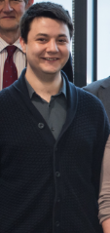
Initial enquiries (light and minimal category of casework)
Nell
Michael
Notes:
Our team follows a process for each enquiry, and all calls are treated as light or minimal at the first engagement. Nell and Michael are office-based and they are our first-responders.

Slide 23


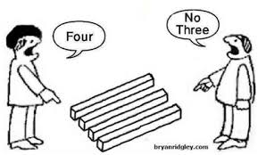


Good morning, The Salvesen Mindroom Centre. Nell/Michael speaking…
Notes:
Although light-hearted in a way, this slide is designed to represent the fact that when we pick up the phone we have no way of knowing what awaits. Callers display a range of emotions – anger, frustration, despair, confusion or stress. It takes skill to be able to field such calls.

Slide 24
How we respond to Initial Enquiries
On the phone
In emails
Using key listening skills:
Empathy
Reflexivity
Understanding
Knowledge
Clarity
Reassurance
Honesty
Courteous and practical
Tailored to individual enquiry:
Key resources, e.g.
It takes all kinds of minds
Enquire’s parents’ guide
Signposting
Web links
Notes:
The skills that our team need to understand the nature of the call they are dealing with, are set out here. Although focussing on ‘calls’ here, we do also receive enquiries by email, and we very often give a detailed response in emails. We always take a lot of care with our response.

Slide 25
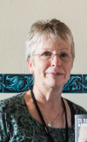


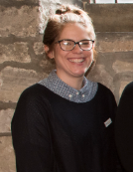
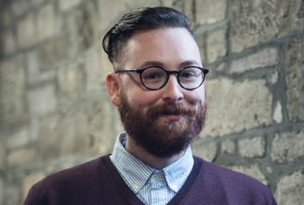
Intermediate and Intensive support
Mig, Lisa
Vicki, Sarah, Aiden
Notes:
For those who need more support at an intermediate of intensive level, Mig and Lisa lead the team and are supported by Vicki, Aiden and Sarah.

Slide 26
GIRFEC (1)
Education (Scotland) Act 2016
Children and Young People (Scotland) Act 2014
Equality Act 2010
Education (Additional Support for Learning) (Scotland) Act 2004
The Education (Disabilities Strategies and Pupils’ Education Records (Scotland) Act 2002
The Children (Scotland) Act 1995
EHCR
Presumption on Mainstreaming
Grant-aided special schools
Independent special schools
Child’s Plan (CP)
Co-ordinated support plan (CSP)
Individualised Education Programme (IEP)
Curriculum for Excellence
National Improvement Framework
Literacy and Numeracy
Empowering Schools
Pupil Equity Funding
Attainment Challenge
Standardised Testing
Assessment is for Learning
Early Years Framework
Child Poverty Strategy
Notes:
As a parent / carer of a child or young person with additional support needs, you enter a whole new world.
And as an organisation supporting parents, carers and professionals the The Salvesen Mindroom Centre team need to be fully up to speed!
When you enter the world of school and education, you find this legislation and guidance Click 1 and Click 2
When you enter the world of additional support needs you encounter some additional legislation, guidance and terminology – Click 3

Slide 27
GIRFEC (2)
Audiologist
Optometrist
Classroom assistant
Paediatrician
Physiotherapist
Third Sector professional
Enquire
Let’s Talk ASN
Children’s Reporter
C&YP Commissioner
Children’s Hearing system
Tribunals
Additional Support Needs Tribunal
Advocacy
Exclusions
Child and Adolescent Mental Health Service (CAHMS)
Waiting Time Targets NHS
Teacher
GP
Additional support for learning teacher
Clinical/Educational Psychologist
Speech and language therapist
Clinical psychologist
Social Worker
Lead professional
Named Person
CSP Coordinator
Notes:
You encounter a whole host of educational and health specialists Click 1 and Click 2
And, you find yourself seeking support from other services, and having to take on board a whole new lexicon.

Slide 28
Engaging with parents
REFER to the Supporting Children’s Learning Code of Practice (revised edition) 2017, for guidance on how to engage with parents (Chapter 7):
You can access the Code on the Scottish Government website www.gov.scot
REMEMBER that the words you use, may simply be ‘jargon’ to parents and carers
IEP/CSP/PSP/CPM/ etc.
NOTE that parents and carers may have learning difficulties too, or may have had a poor school experience themselves
Notes:
Delivering a service of this kind to families who face all of these potential problems and a complex policy and legal sytem is all about the relationship with parents and carers.
Parental engagement is a key policy for education authorities, and the value of including parents in their child’s education is widely agreed upon. However, when parents or carers fall into dispute or are unhappy with their child’s school meaningful parental engagement is very difficult to achieve.
Government guidance exists in many places and here we highlight the ASL Code of Practice, which has a section devoted to parental engagement.
The second bullet point here, may seem obvious, but it is so important. As professionals we are all guilty of using shorthand for sometimes complicated ideas or processes. SHOW OF HANDS – can everyone here interpret the 4 acronyms we’ve shown here?
Many parents/carers we support have learning difficulties themselves, and this can make the building of positive relationships all the more difficult. It’s important to be alert to this possibility, whether or not the parent discloses the information to you. You may need to offer information in different forms, and to use alternative communication methods such as texts. Written communication may not always be suitable. In addition, the school environment may be one that some adults just don’t have good feelings about because of their own poor experience. Again, having awareness and sensitivity to this, is a good first step to building positive relationships.

Slide 29
Tools and resources
We have a variety of resources for parents and professionals
These can be used to support the young person to express their views
They can show school staff what an individual needs from them
They give information to parents in a way that is easy to manage
Notes:
We have with us some of the resources we give to parents and carers and we are going to highlight these and pass some examples round now.

Slide 30

It takes all kinds of minds
You can access the guide on the reources page of our website, www.mindroom.org
Notes:
This is the resource we would most commonly provide to parents and professionals. Many of you will be familiar with this booklet, It takes all kinds of minds as it was sent to every GTCS registered teacher in the autumn. Since then, a good number of schools have asked us for more copies for non-teaching staff and in several cases for the whole school community. It has application beyond schools, too, and we have provided it to education officers in outdoor education centres, residential units and voluntary bodies, such as Cycling Scotland.

Slide 31
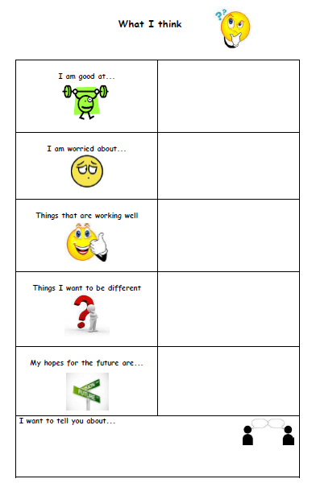
Child’s views
Notes:
It is so important that the children and young people are given a chance to express their views and the form on this slide and the next are a simple way of allowing them to do that. (Handouts).
Taking the child’s view is not a once-only event – these forms can be renewed and refreshed at regular intervals.

Slide 32
Young person’s views
2017 Things that are working well
Things I am worried about
Things I want to be different
Things I want to tell you about
Notes:
Making use of this type of form as a matter of course helps to meet legal requirements about always having regard to the views of children and young person (UNCRC).
We find using these forms helps in 2 ways – it’s a reminder to the parent to put forward their child’s views, and not always their own view. And it is a good way to put on record with the school what the child’s needs and preferences are.
From your experience, would you find these helpful in a meeting, to allow you to focus on the child or young person?

Slide 33

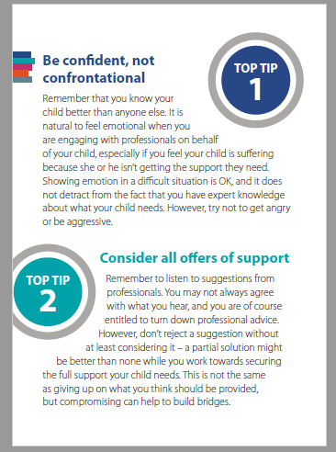
Top Ten Tips for parents and carers
Notes:
Top Ten Tips is a resource we developed based on the advice we most commonly give to parents and carers. We know these techniques can really help to improve understanding and communication on both sides. Although it is targeted at parents and carers, as professionals, you can see from the Tips that your own practice can be adapted to take on board the parents view and meet their expectations.
We’re trying to encourage parents to self-advocate, but in a measured way.
We’re also keen that parents don’t get stuck on thinking there’s only one answer to the difficulty – we encourage them to at least consider all the offers of help from schools and not reject anything out of hand.

Slide 34
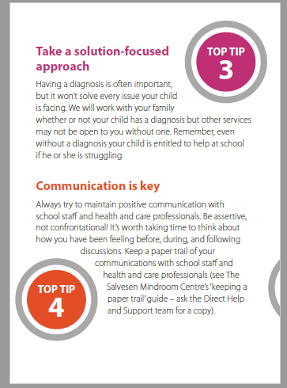
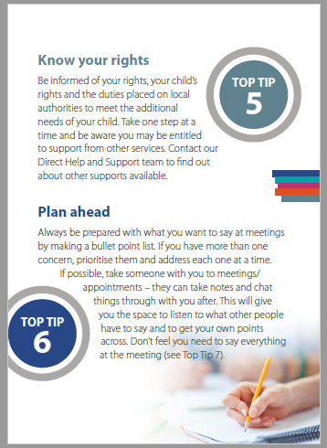
Notes:
Many parents worry that without a diagnosis the child won’t get any help. We will support them without a diagnosis, and we try to encourage thinking about the solutions rather than naming the problem.
We focus on positive communication, and encourage parents to be reflective about their feelings – being aware of their feelings before they go into a meeting can help take the heat out of the situation and make potentially difficult meetings more manageable.
Keeping records can also help.
Information is very important to parents, and we try to make sure everyone is aware of the legal position on rights and entitlements. Having this knowledge empowers parents and helps them feel more confident about advocating for their child.
Meetings are a precious use of everyone’s time, so we try to support parents to plan ahead to make the best use of them.

Slide 35
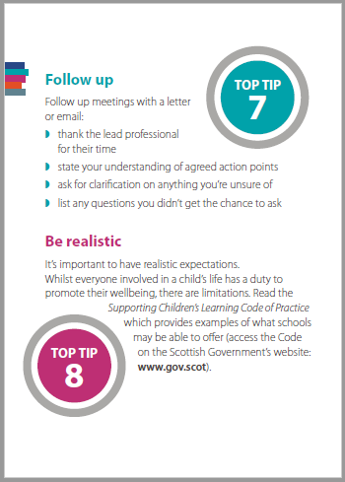
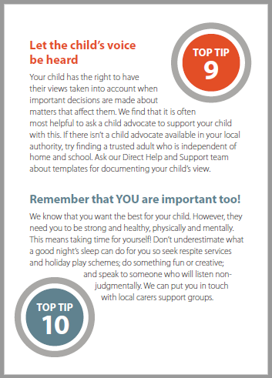
Notes:
We support parents to follow up meetings to ensure everyone is clear about what has been agreed and avoid future misunderstandings.
Top Tip 8 is about being realistic – if we only spoke about rights and entitlements we’d probably create more conflict, so we try to discuss the things that seem most possible or most likely for each set of circumstances, balanced with the needs of the child or young person.
We’ve already mentioned the importance of hearing the child’s views. As well as the resources we’ve shown you, we signpost advocacy services, where appropriate. And, of course, there is a new service for 12 – 15 year olds who want to take part in decisions about their own additional support for learning, which we also signpost.
Finally, we do encourage parents and carers to think about their own needs.

Slide 36

Things to not say to parents
There are 30 children in my classroom
Other people are worse off than you/your child
We don’t see that behavior at school. The problem must be at home
Notes:
We often hear of things which professionals say to parents/carers which can make an already tense situation worse!
Whilst we completely understand that pressures that teachers are under, I hope you will allow me to offer these tips for you:
Parents don’t want to be told that there are 29 other children in the classroom. They are well aware of this but their focus is on their child
They also don’t want to hear that there are other CYP who are in a worse position. In our experience, the families we support struggle to feel that they are being heard and this adds to that feeling
Going back to the coke bottle effect, sometimes it isn’t until a child gets home that the stresses of the day manifest in difficult behaviours. Don’t assume that a behavior is the result of poor parenting or the situation at home, and that the school environment is working perfectly well for the child.

Slide 37
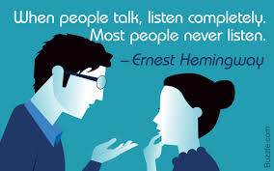
One Top Tip for Teachers
Always do your best to make the parent/carer (and the child or young person) feel they are being listened to
Notes:
The final piece of advice we would like to offer is to listen. When you are busy and dealing with competing pressures and conflicting demands, this can seem like an extra burden. You will almost certainly find, though, that making the time to allow a parent/carer to speak to you and feel that they have your attention, will pay off in the long run.

Slide 38
Contact us
directhelp@mindroom.org
0131 475 2330
The Salvesen Mindroom Centre is a registered Scottish charity SC030472
A company limited by guarantee and registered in Scotland SC209656
Notes:
It is very easy to access our services – families can call or email us. You can make a referral – if you have the family’s permission to give details we will make the first contact with them.
Questions? Discussion?

